Slide 1
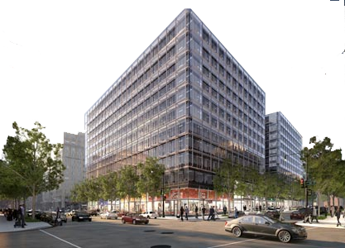
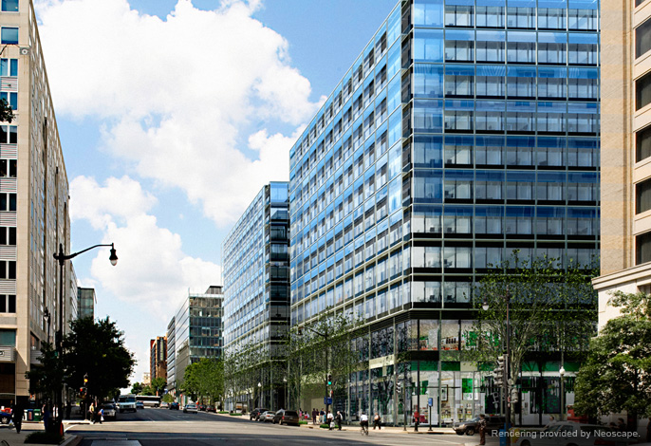
Introduction
Andy Penev
Construction Management
CityCenterDC | Parcel 1
Washington, D.C.

Slide 2
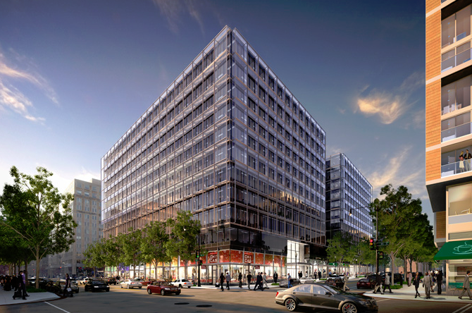
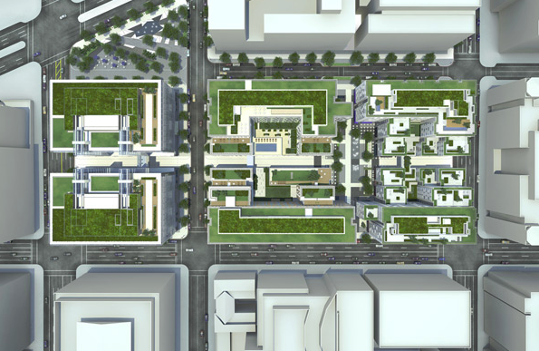







CityCenterDC | Parcel 1
Washington, D.C.
Project Overview
Andy Penev
Construction Management
Size: 257,500 SF
Location: Washington, D.C.
Project Cost: $48 million
Contract Type: (4) GMP
Delivery Method: Design-Bid-Build
Schedule: 4/11 – 1/14
Developer: Hines|Archstone
General Contractor: Clark/Smoot (JV)
Arch. of Record: Shalom Baranes Associates
Design Architect: Foster + Partners
Project Overview
Analysis #1: SIPS
Background Information
New Phasing & SIPS
Impact
Analysis #2: Electrical Redesign
Background Information
Redesign
Impact
Analysis #3: Footbridge Installation
Background Information
Research
Application
Results
Final Recommendations
Acknowledgements

Slide 3
CityCenterDC | Parcel 1
Washington, D.C.
Andy Penev
Construction Management
Analysis #1: SIPS
Create a new phasing and sequencing plan for typical floor and implement through a Short Interval Production Schedule.
Analysis #2: Construction Analysis of Electrical Redesign
Propose an alternative electrical distribution system design and analyze its construction impacts.
Analysis #3: Alternative Footbridge Installation
Provide an alternative footbridge installation method to reduce cost and constructability issues.
Project Overview
Analysis #1: SIPS
Background Information
New Phasing & SIPS
Impact
Analysis #2: Electrical Redesign
Background Information
Redesign
Impact
Analysis #3: Footbridge Installation
Background Information
Research
Application
Results
Final Recommendations
Acknowledgements

Slide 4
CityCenterDC | Parcel 1
Washington, D.C.
Andy Penev
Construction Management
Project Overview
Analysis #1: SIPS
Background Information
New Phasing & SIPS
Impact
Analysis #2: Electrical Redesign
Background Information
Redesign
Impact
Analysis #3: Footbridge Installation
Background Information
Research
Application
Results
Final Recommendations
Acknowledgements
Analysis #1
Short Interval Production Schedule (SIPS)

Slide 5
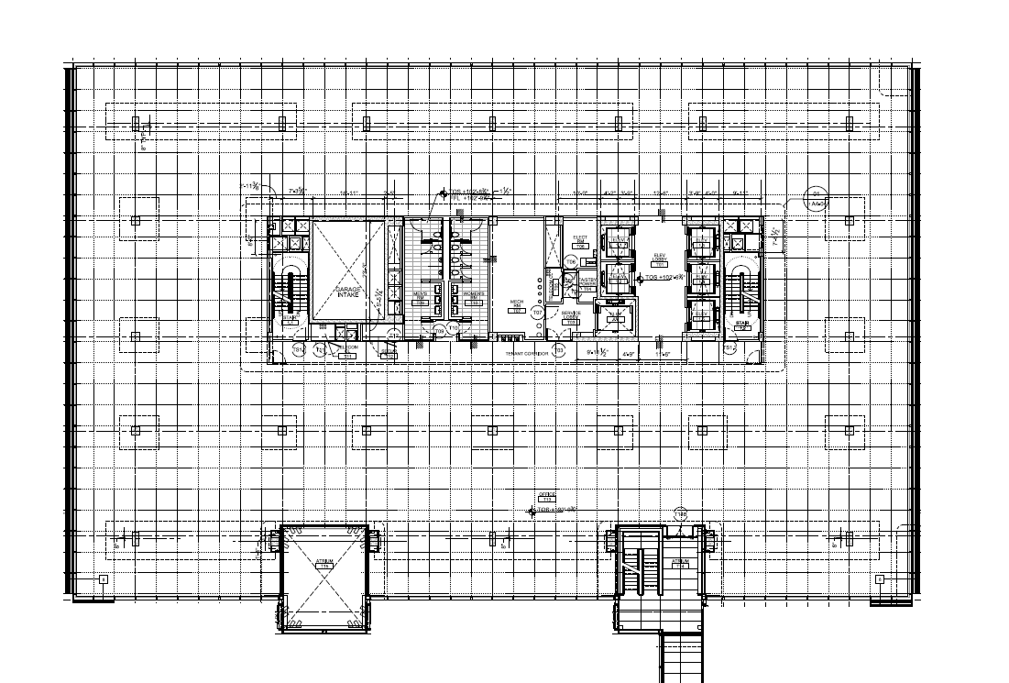
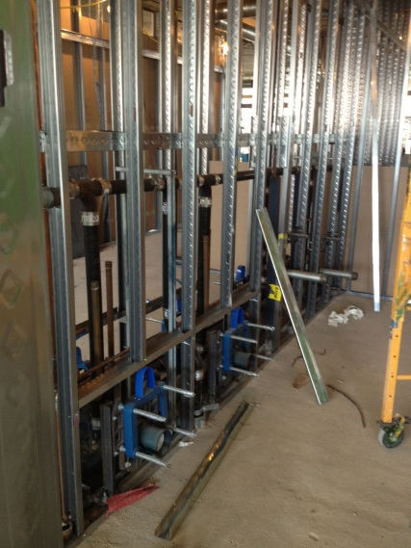
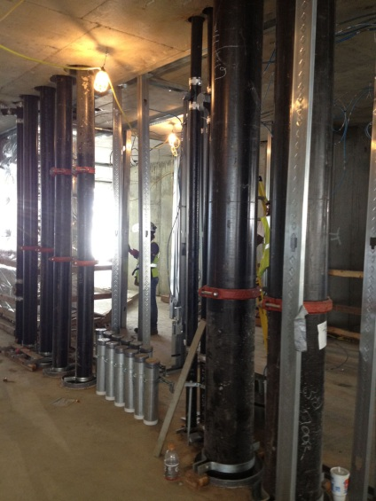
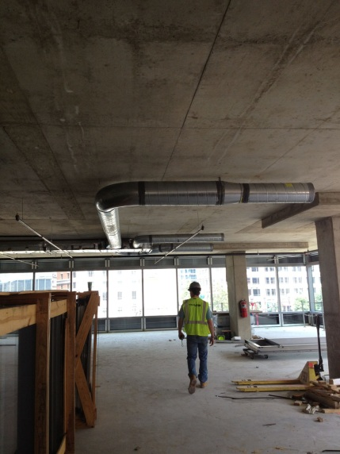
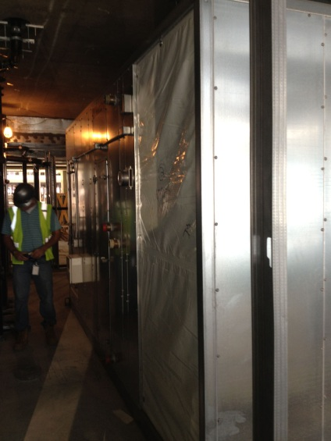
Analysis #1: SIPS
Background Information
CityCenterDC | Parcel 1
Washington, D.C.
Project Overview
Analysis #1: SIPS
Background Information
New Phasing & SIPS
Impact
Analysis #2: Electrical Redesign
Background Information
Redesign
Impact
Analysis #3: Footbridge Installation
Background Information
Research
Application
Results
Final Recommendations
Acknowledgements
Framing & Plumbing Rough In
Risers
Mechanical Duct
AHU

Slide 6
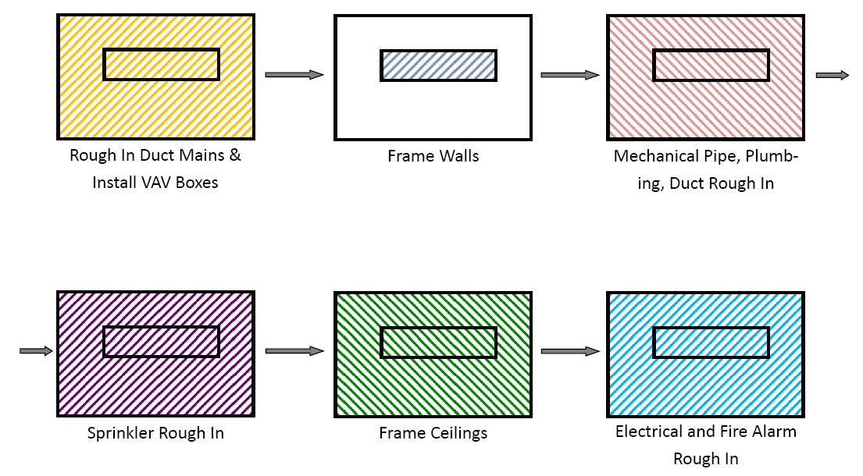
Analysis #1: SIPS
Background Information
CityCenterDC | Parcel 1
Washington, D.C.
Project Overview
Analysis #1: SIPS
Background Information
New Phasing & SIPS
Impact
Analysis #2: Electrical Redesign
Background Information
Redesign
Impact
Analysis #3: Footbridge Installation
Background Information
Research
Application
Results
Final Recommendations
Acknowledgements
Framing & Plumbing Rough In
Risers
Mechanical Duct
AHU

Slide 7
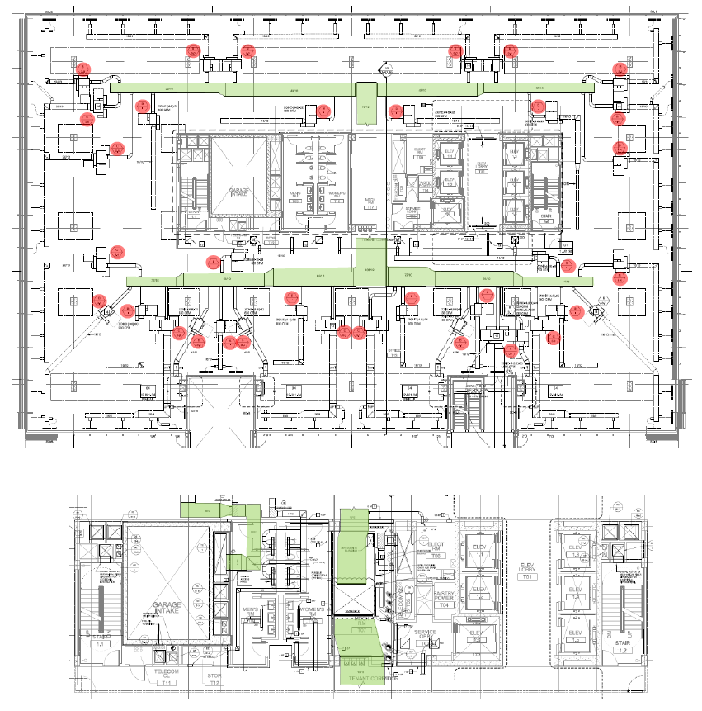
Analysis #1: SIPS
New Phasing
CityCenterDC | Parcel 1
Washington, D.C.
Project Overview
Analysis #1: SIPS
Background Information
New Phasing & SIPS
Impact
Analysis #2: Electrical Redesign
Background Information
Redesign
Impact
Analysis #3: Footbridge Installation
Background Information
Research
Application
Results
Final Recommendations
Acknowledgements
Identify Duct Mains
Identify VAV Boxes

Slide 8
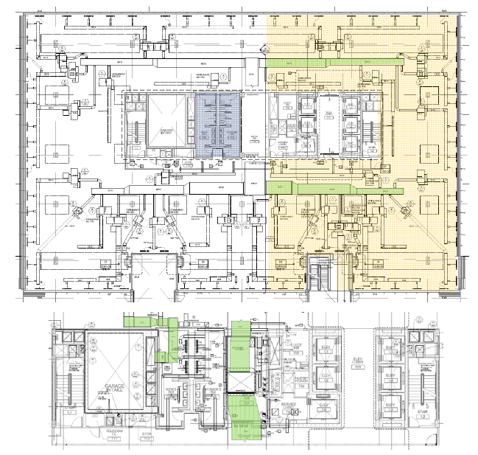
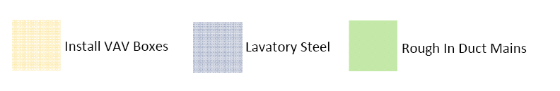
Analysis #1: SIPS
New Phasing
CityCenterDC | Parcel 1
Washington, D.C.
Project Overview
Analysis #1: SIPS
Background Information
New Phasing & SIPS
Impact
Analysis #2: Electrical Redesign
Background Information
Redesign
Impact
Analysis #3: Footbridge Installation
Background Information
Research
Application
Results
Final Recommendations
Acknowledgements
Identify Duct Mains
Identify VAV Boxes

Slide 9
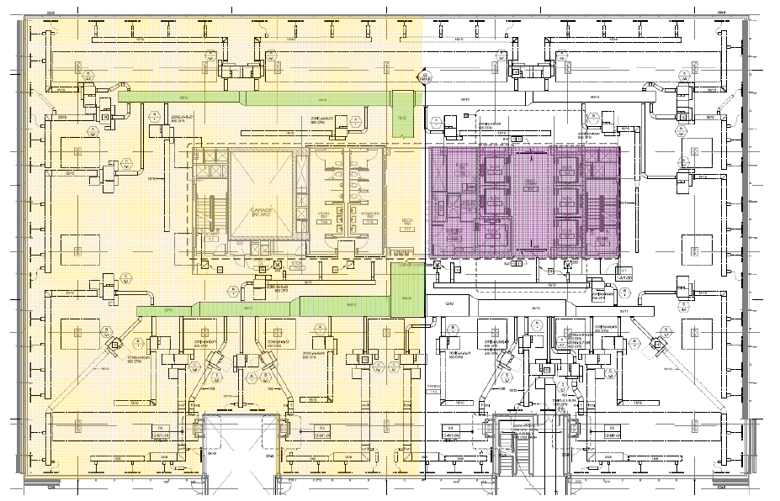

Analysis #1: SIPS
New Phasing
CityCenterDC | Parcel 1
Washington, D.C.
Project Overview
Analysis #1: SIPS
Background Information
New Phasing & SIPS
Impact
Analysis #2: Electrical Redesign
Background Information
Redesign
Impact
Analysis #3: Footbridge Installation
Background Information
Research
Application
Results
Final Recommendations
Acknowledgements
Identify Duct Mains
Identify VAV Boxes

Slide 10
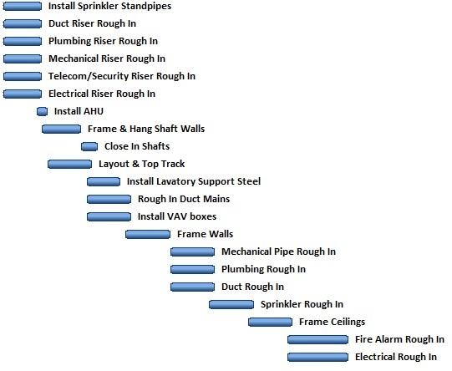
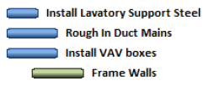
Analysis #1: SIPS
New Phasing
CityCenterDC | Parcel 1
Washington, D.C.
Create zones on each floor
Crew stays in zone for given amount of time
Creates efficient use of space
Entire floor space is used
Important:
Clean up
Timely completion
Material management
Project Overview
Analysis #1: SIPS
Background Information
New Phasing & SIPS
Impact
Analysis #2: Electrical Redesign
Background Information
Redesign
Impact
Analysis #3: Footbridge Installation
Background Information
Research
Application
Results
Final Recommendations
Acknowledgements

Slide 11
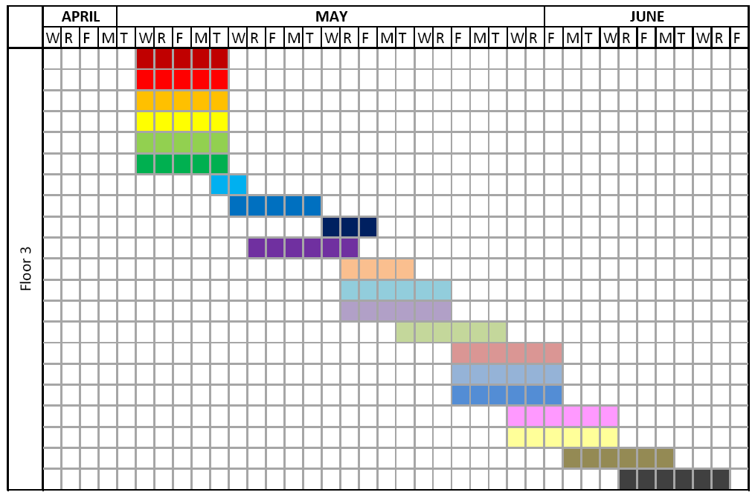
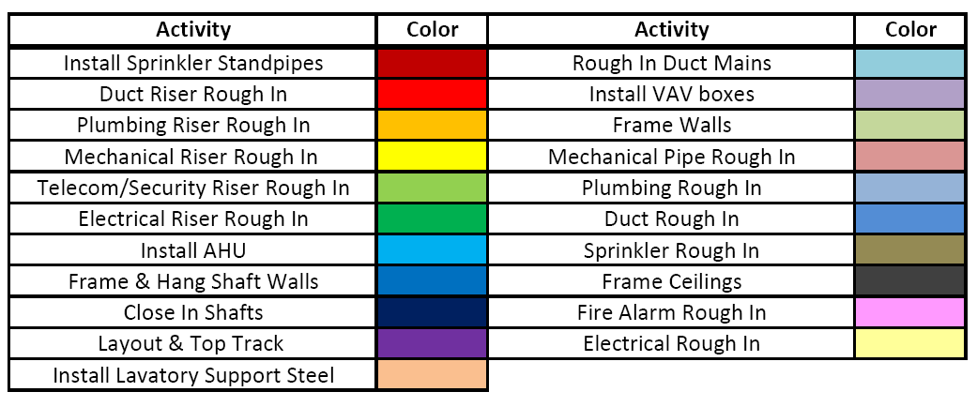
Analysis #1: SIPS
SIPS
CityCenterDC | Parcel 1
Washington, D.C.
Project Overview
Analysis #1: SIPS
Background Information
New Phasing & SIPS
Impact
Analysis #2: Electrical Redesign
Background Information
Redesign
Impact
Analysis #3: Footbridge Installation
Background Information
Research
Application
Results
Final Recommendations
Acknowledgements
Short Interval Production Schedule
Same crew
Same duration
Reorganization
Overlapping activities
Float on second half of activities

Slide 12
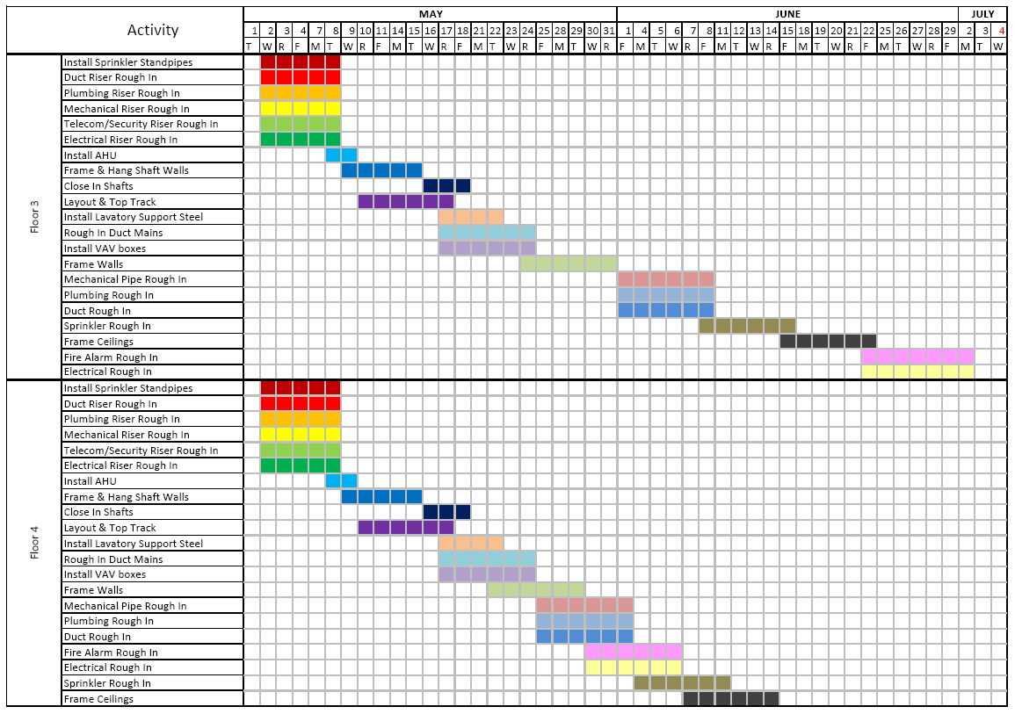
Analysis #1: SIPS
Results
CityCenterDC | Parcel 1
Washington, D.C.
Cost
General Conditions
Total Savings = $20,524
Schedule
Decreased by 13 days
Project Overview
Analysis #1: SIPS
Background Information
New Phasing & SIPS
Impact
Analysis #2: Electrical Redesign
Background Information
Redesign
Impact
Analysis #3: Footbridge Installation
Background Information
Research
Application
Results
Final Recommendations
Acknowledgements
Constructability
Organization
Collaboration
Delays
Material Management
Deliveries

Slide 13
CityCenterDC | Parcel 1
Washington, D.C.
Andy Penev
Construction Management
Project Overview
Analysis #1: SIPS
Background Information
New Phasing & SIPS
Impact
Analysis #2: Electrical Redesign
Background Information
Redesign
Impact
Analysis #3: Footbridge Installation
Background Information
Research
Application
Results
Final Recommendations
Acknowledgements
Analysis #2
Construction Analysis of Electrical Redesign

Slide 14
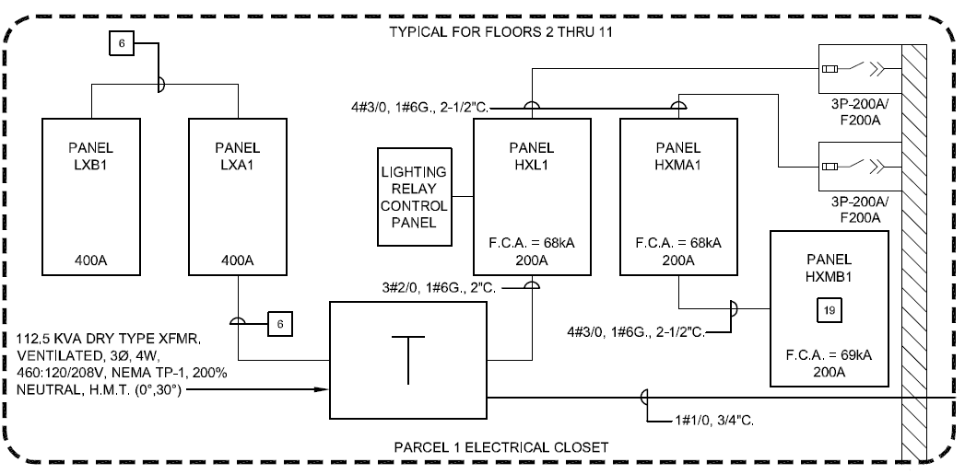
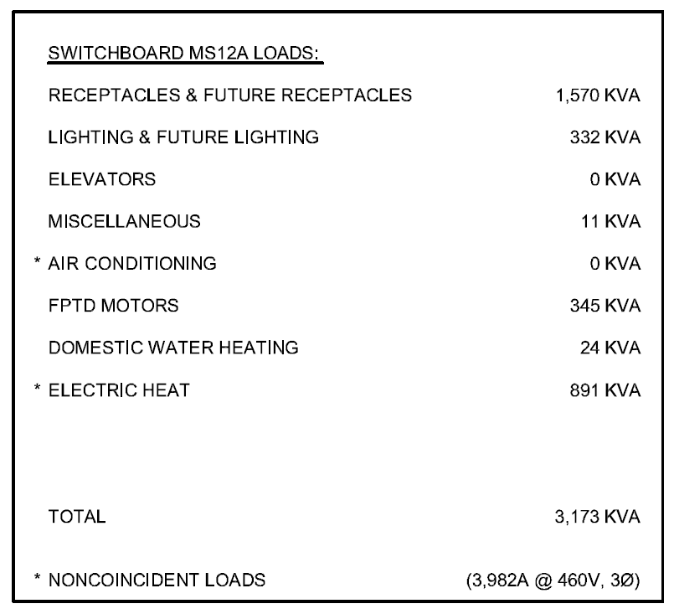
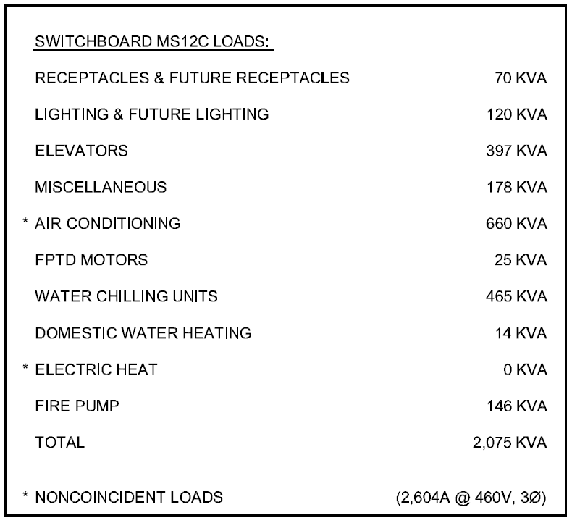
Analysis #2: Electrical Redesign
Background Information
CityCenterDC | Parcel 1
Washington, D.C.
2 Switchboards (4000A & 3000A)
Total kVA = 5,248
  20.4 W/SF
Separate retail feed
Lighting + Receptacle load = 2,092 kVA
  7.7 W/SF
4000A SWBD busway to electrical closets
  Took most of lighting and receptacle loads (1,902 kVA)
Project Overview
Analysis #1: SIPS
Background Information
New Phasing & SIPS
Impact
Analysis #2: Electrical Redesign
Background Information
Redesign
Impact
Analysis #3: Footbridge Installation
Background Information
Research
Application
Results
Final Recommendations
Acknowledgements

Slide 15
Analysis #2: Electrical Redesign
Redesign
CityCenterDC | Parcel 1
Washington, D.C.
Project Overview
Analysis #1: SIPS
Background Information
New Phasing & SIPS
Impact
Analysis #2: Electrical Redesign
Background Information
Redesign
Impact
Analysis #3: Footbridge Installation
Background Information
Research
Application
Results
Final Recommendations
Acknowledgements
 | kVA Load | FLA | Voltage | Phase | SWBD Size
Initial SWBD | 3173 | 3982 | 480 | 3 | 4000A
Revised SWBD | 2373 | 2978 | 480 | 3 | 3000A
ASHRAE Maximum Lighting Power Density = 0.9 W/SF
Receptacle Load = 2.4 W/SF
Total= 3.3 W/SF

Slide 16
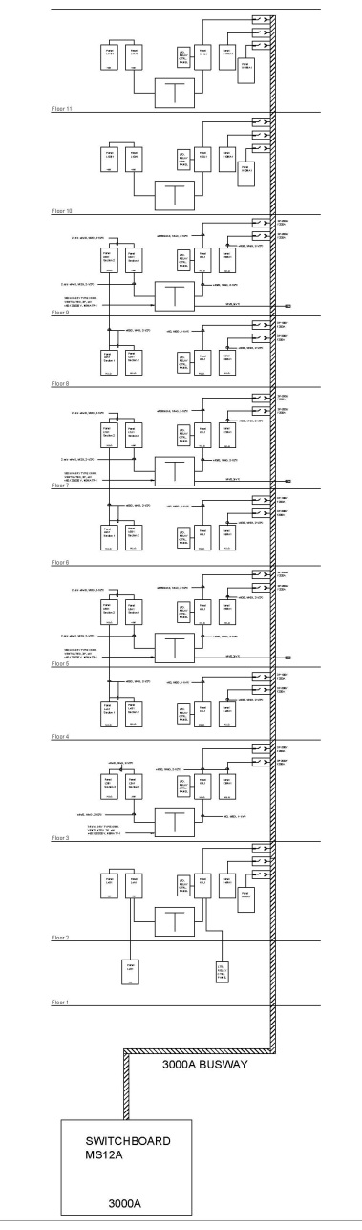
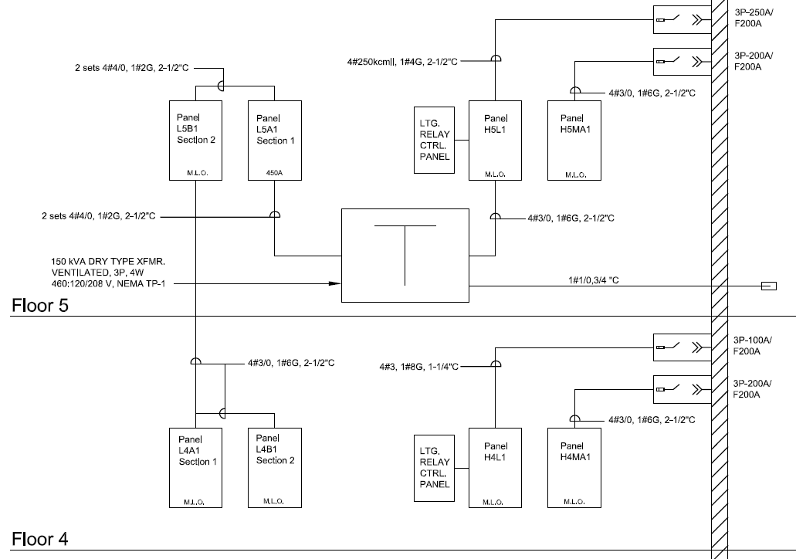
Analysis #2: Electrical Redesign
Redesign
CityCenterDC | Parcel 1
Washington, D.C.
Eliminate XFMR on floors 4,6, & 8
  Feed low voltage panels from floor above
Floors 5,7, & 9 XFMR step up to 150kVa
Feeders, plugs, breakers
Coordination of cores
  Fireproofing
Project Overview
Analysis #1: SIPS
Background Information
New Phasing & SIPS
Impact
Analysis #2: Electrical Redesign
Background Information
Redesign
Impact
Analysis #3: Footbridge Installation
Background Information
Research
Application
Results
Final Recommendations
Acknowledgements

Slide 17
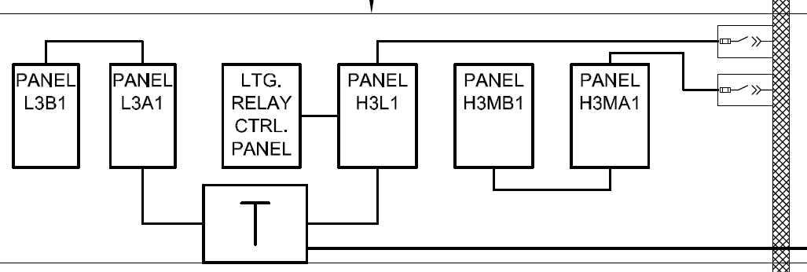
Analysis #2: Electrical Redesign
Redesign
CityCenterDC | Parcel 1
Washington, D.C.
Eliminate XFMR on floors 4,6, & 8
  Feed low voltage panels from floor above
Floors 5,7, & 9 XFMR step up to 150kVa
Feeders, plugs, breakers
Coordination of cores
  Fireproofing
Consolidation of HVAC panels
Project Overview
Analysis #1: SIPS
Background Information
New Phasing & SIPS
Impact
Analysis #2: Electrical Redesign
Background Information
Redesign
Impact
Analysis #3: Footbridge Installation
Background Information
Research
Application
Results
Final Recommendations
Acknowledgements
Smaller XFMR from reduced loads on 3rd floor
Feeders

Slide 18
Analysis #2: Electrical Redesign
Results
CityCenterDC | Parcel 1
Washington, D.C.
Schedule
Project Overview
Analysis #1: SIPS
Background Information
New Phasing & SIPS
Impact
Analysis #2: Electrical Redesign
Background Information
Redesign
Impact
Analysis #3: Footbridge Installation
Background Information
Research
Application
Results
Final Recommendations
Acknowledgements
ELECTRICAL RISER ROUGH IN | Hours per Floor | Crew Size
Original Design (5 day duration) | 76 | 2
Redesign Floor w/ XFMR | 79.75 | 2
Redesign Floor w/o XFMR | 31.42 | 1*
ELECTRICAL ROUGH IN | Hours per Floor | Crew Size
Original Design | 149 | 4
Redesign Floor w/ XFMR | 142.33 | 4
Redesign Floor w/o XFMR | 148.33 | 4
Total labor hours saved: 182
Dependency
Resource allocation

Slide 19
Analysis #2: Electrical Redesign
Results
CityCenterDC | Parcel 1
Washington, D.C.
Schedule
Cost
Project Overview
Analysis #1: SIPS
Background Information
New Phasing & SIPS
Impact
Analysis #2: Electrical Redesign
Background Information
Redesign
Impact
Analysis #3: Footbridge Installation
Background Information
Research
Application
Results
Final Recommendations
Acknowledgements
ELECTRICAL RISER ROUGH IN | Hours per Floor | Crew Size
Original Design (5 day duration) | 76 | 2
Redesign Floor w/ XFMR | 79.75 | 2
Redesign Floor w/o XFMR | 31.42 | 1*
Savings = $120,940
ELECTRICAL ROUGH IN | Hours per Floor | Crew Size
Original Design | 149 | 4
Redesign Floor w/ XFMR | 142.33 | 4
Redesign Floor w/o XFMR | 148.33 | 4
Total labor hours saved: 182
Dependency
Resource allocation
Original
Redesign

Slide 20
Analysis #2: Electrical Redesign
Results
CityCenterDC | Parcel 1
Washington, D.C.
Schedule
Cost
Constructability
Project Overview
Analysis #1: SIPS
Background Information
New Phasing & SIPS
Impact
Analysis #2: Electrical Redesign
Background Information
Redesign
Impact
Analysis #3: Footbridge Installation
Background Information
Research
Application
Results
Final Recommendations
Acknowledgements
ELECTRICAL RISER ROUGH IN | Hours per Floor | Crew Size
Original Design (5 day duration) | 76 | 2
Redesign Floor w/ XFMR | 79.75 | 2
Redesign Floor w/o XFMR | 31.42 | 1*
Item | Labor Hours
4000A Busway (59.4 lb/ft) | 719.9
3000A Busway (42.7 lb/ft) | 626
Labor Savings | 93.9
Savings = $120,940
ELECTRICAL ROUGH IN | Hours per Floor | Crew Size
Original Design | 149 | 4
Redesign Floor w/ XFMR | 142.33 | 4
Redesign Floor w/o XFMR | 148.33 | 4
Horizontal bus runs quicker with lighter material
Less panels
Less XFMRs
Less cluttered electrical closet
Coring coordination
Fireproofing
Total labor hours saved: 182
Dependency
Resource allocation
Original
Redesign

Slide 21
CityCenterDC | Parcel 1
Washington, D.C.
Andy Penev
Construction Management
Project Overview
Analysis #1: SIPS
Background Information
New Phasing & SIPS
Impact
Analysis #2: Electrical Redesign
Background Information
Redesign
Impact
Analysis #3: Footbridge Installation
Background Information
Research
Application
Results
Final Recommendations
Acknowledgements
Analysis #3
Alternative Footbridge Installation

Slide 22
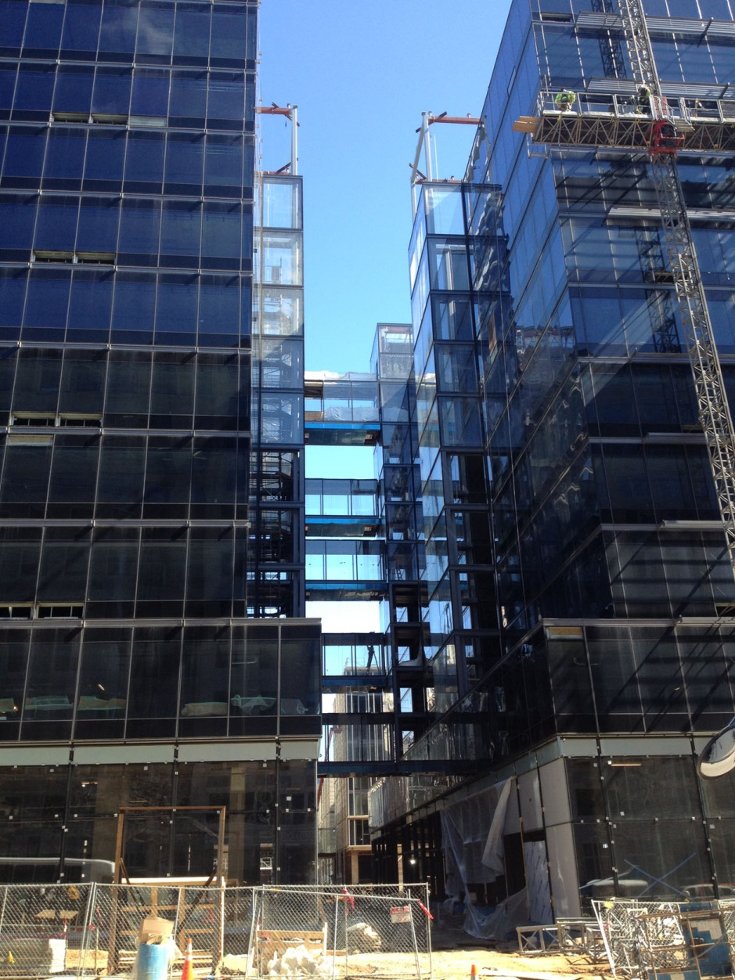
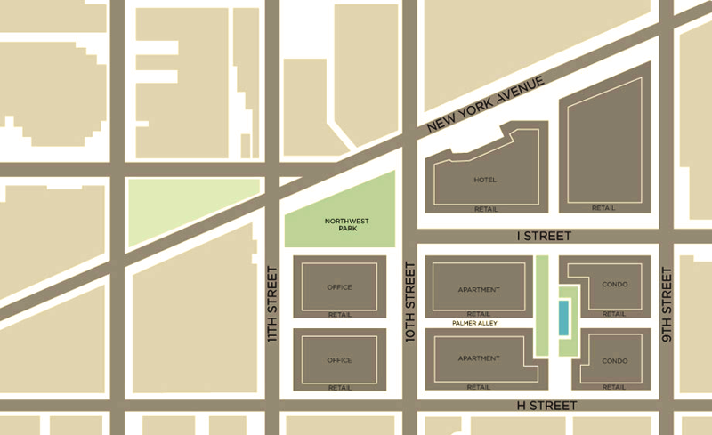
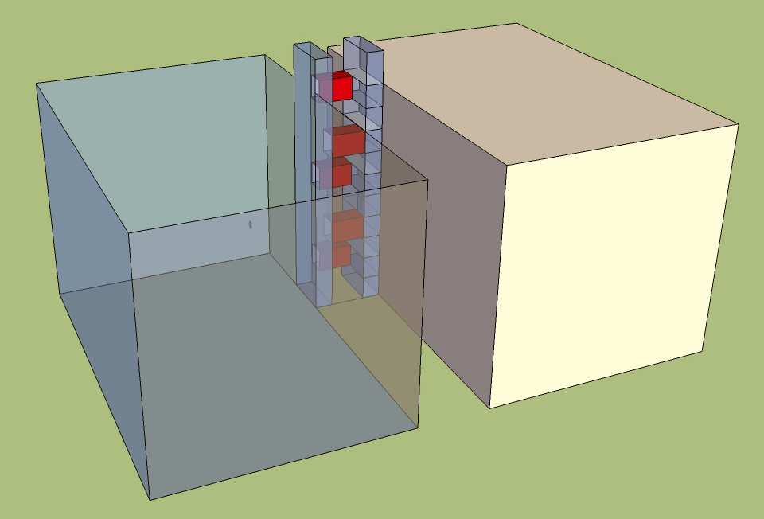
Analysis #3: Footbridges
Background Information
CityCenterDC | Parcel 1
Washington, D.C.
5 footbridges in between office buildings
Steel
Curtain wall
On floors 3,5,7,9, & 11
Project Overview
Analysis #1: SIPS
Background Information
New Phasing & SIPS
Impact
Analysis #2: Electrical Redesign
Background Information
Redesign
Impact
Analysis #3: Footbridge Installation
Background Information
Research
Application
Results
Final Recommendations
Acknowledgements

Slide 23
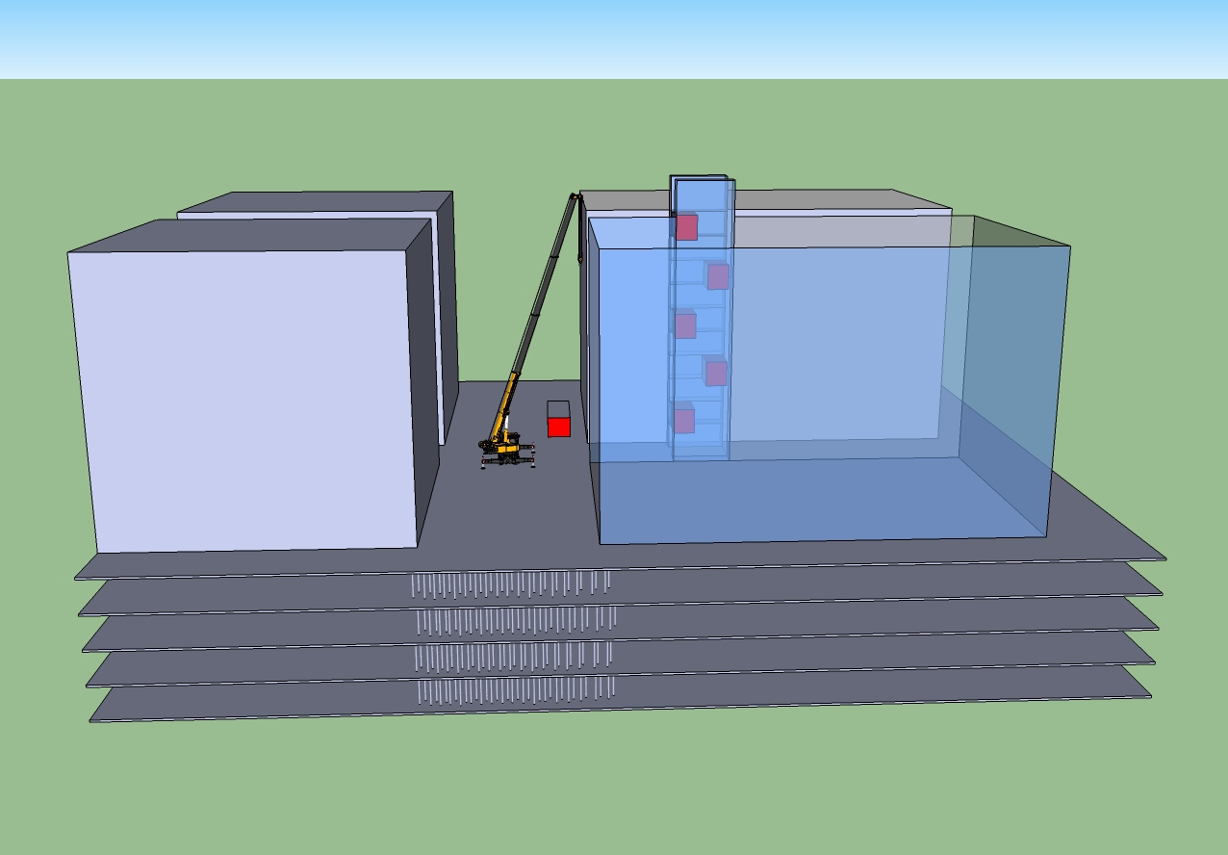
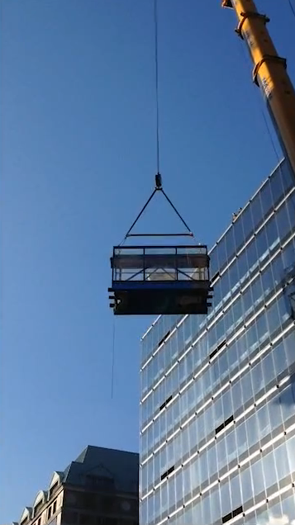
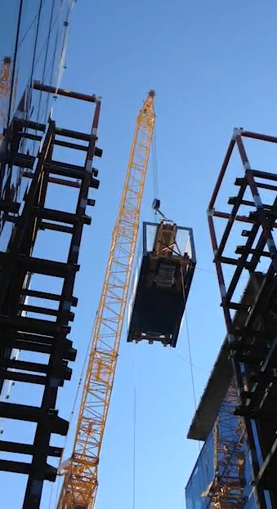
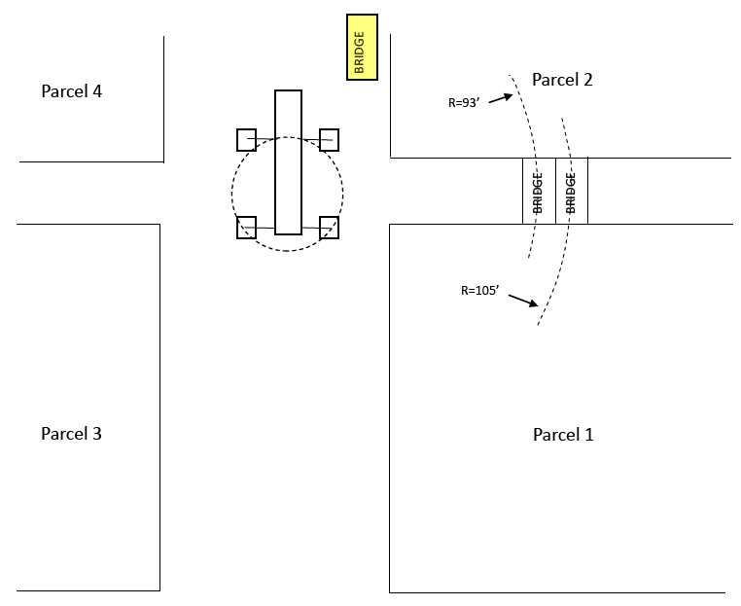
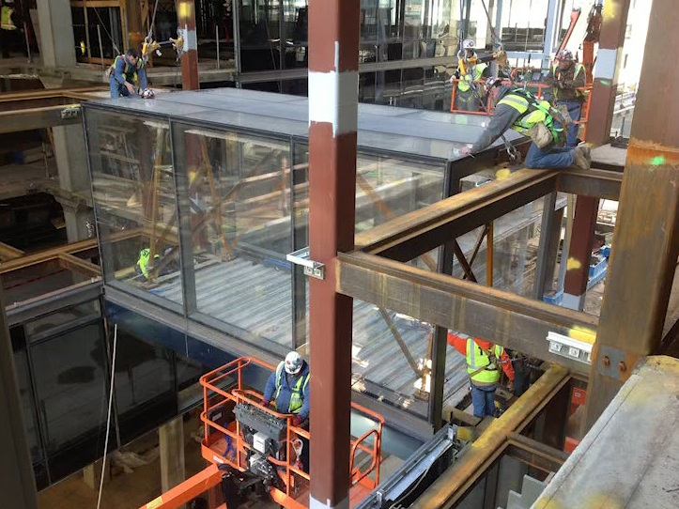
Analysis #3: Footbridges
Background Information
CityCenterDC | Parcel 1
Washington, D.C.
Bridges
Prefabrication
  Including curtain wall
  Too much risk building in place
20’ long/each
36,666 lbs./each
Crane
500 ton mobile
220,500 lbs counterweight
138’ jib length
51,717 lifting capacity
Shoring underneath
Project Overview
Analysis #1: SIPS
Background Information
New Phasing & SIPS
Impact
Analysis #2: Electrical Redesign
Background Information
Redesign
Impact
Analysis #3: Footbridge Installation
Background Information
Research
Application
Results
Final Recommendations
Acknowledgements

Slide 24
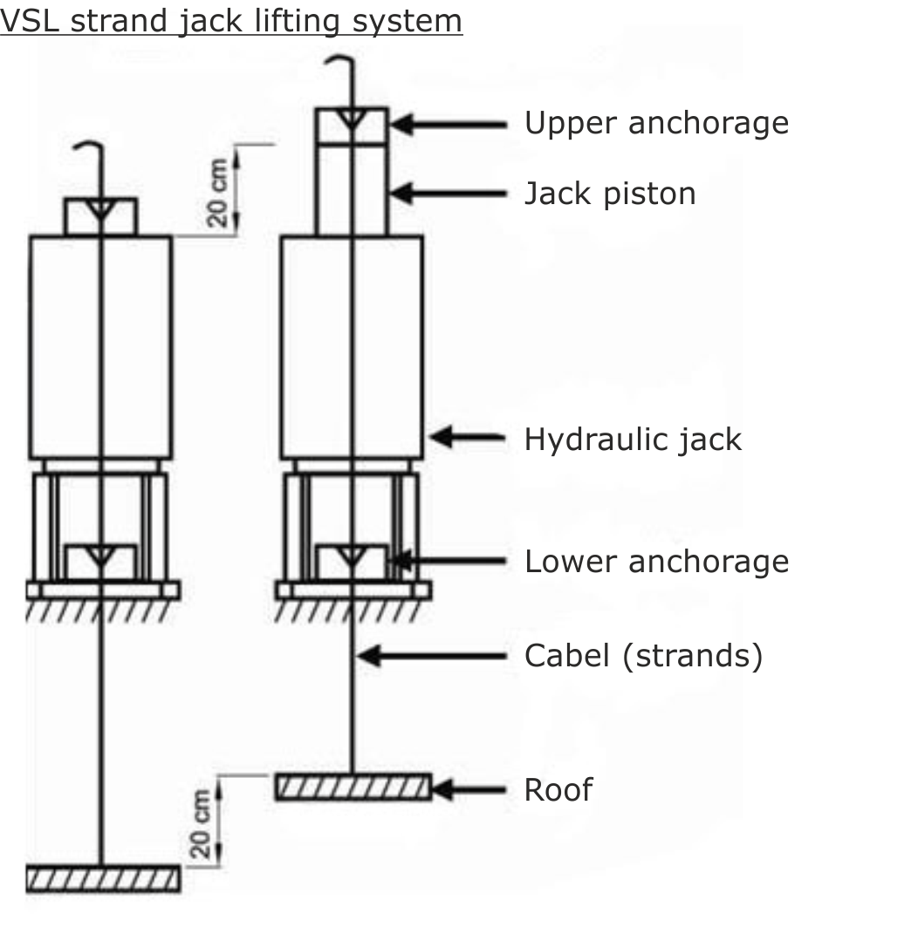
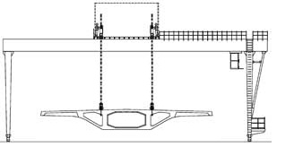
Analysis #3: Footbridges
Research
CityCenterDC | Parcel 1
Washington, D.C.
VSL Heavy Lifting
Project Overview
Analysis #1: SIPS
Background Information
New Phasing & SIPS
Impact
Analysis #2: Electrical Redesign
Background Information
Redesign
Impact
Analysis #3: Footbridge Installation
Background Information
Research
Application
Results
Final Recommendations
Acknowledgements
“For projects where notable weight, dimensions, or space limitations exclude the use of cranes or other conventional handling.” (VSL)
Hydraulic jacks
  Piston
  Tensile member
Gauges and control systems
  Synchronized movement
20 m/hr
Up to 10,000 tons

Slide 25
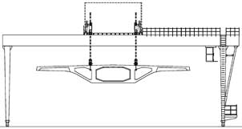
Analysis #3: Footbridges
Research
CityCenterDC | Parcel 1
Washington, D.C.
VSL Heavy Lifting
Project Overview
Analysis #1: SIPS
Background Information
New Phasing & SIPS
Impact
Analysis #2: Electrical Redesign
Background Information
Redesign
Impact
Analysis #3: Footbridge Installation
Background Information
Research
Application
Results
Final Recommendations
Acknowledgements
“For projects where notable weight, dimensions, or space limitations exclude the use of cranes or other conventional handling.” (VSL)
Hydraulic jacks
  Piston
  Tensile member
Gauges and control systems
  Synchronized movement
20 m/hr
Up to 10,000 tons

Slide 26
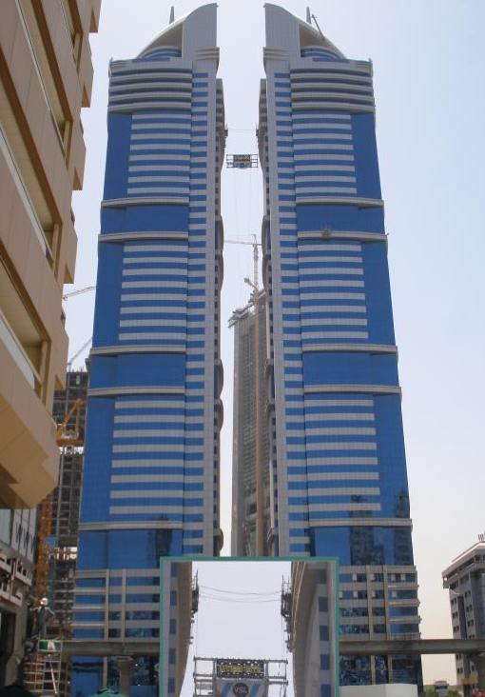
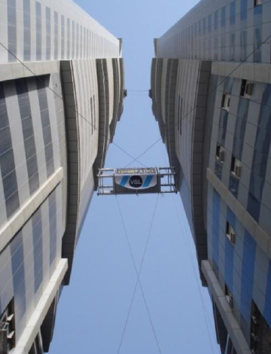
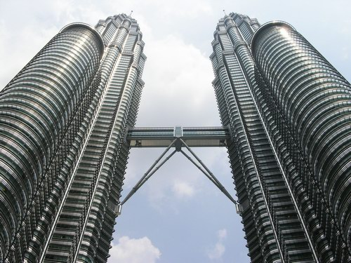
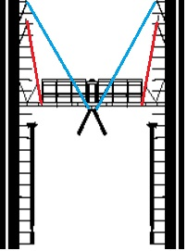
Analysis #3: Footbridges
Research
CityCenterDC | Parcel 1
Washington, D.C.
Damas Tower Footbridge
VSL Heavy Lifting
Project Overview
Analysis #1: SIPS
Background Information
New Phasing & SIPS
Impact
Analysis #2: Electrical Redesign
Background Information
Redesign
Impact
Analysis #3: Footbridge Installation
Background Information
Research
Application
Results
Final Recommendations
Acknowledgements
“For projects where notable weight, dimensions, or space limitations exclude the use of cranes or other conventional handling.” (VSL)
Hydraulic jacks
  Piston
  Tensile member
Gauges and control systems
  Synchronized movement
20 m/hr
Up to 10,000 tons
Petronas Towers

Slide 27
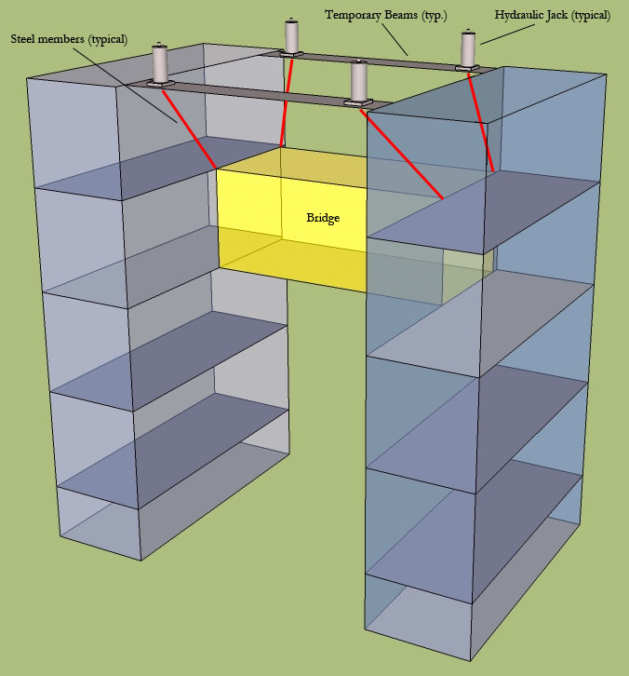
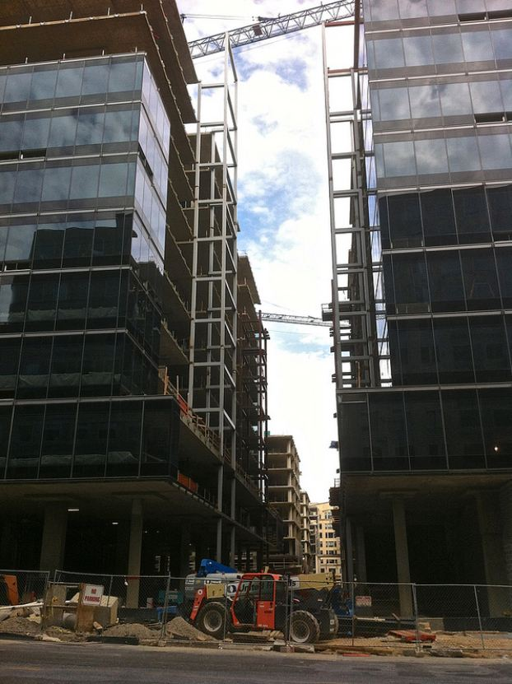
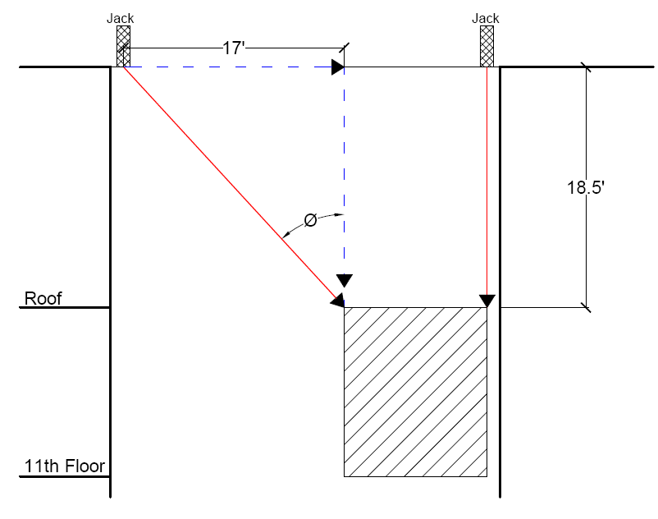
Analysis #3: Footbridges
Application
CityCenterDC | Parcel 1
Washington, D.C.
Project Overview
Analysis #1: SIPS
Background Information
New Phasing & SIPS
Impact
Analysis #2: Electrical Redesign
Background Information
Redesign
Impact
Analysis #3: Footbridge Installation
Background Information
Research
Application
Results
Final Recommendations
Acknowledgements
4 jacks
Temporary beams span between atriums
Structural Considerations
  Steel strands
    Max. force: 12.6 kips
  Temporary beams
    Moment: 25.2 ft k
  Column buckling
    F.S. = 3.4

Slide 28
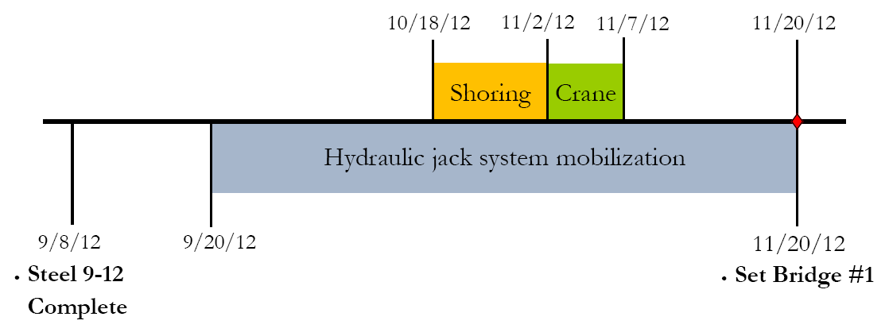
Analysis #3: Footbridges
Results
CityCenterDC | Parcel 1
Washington, D.C.
Schedule
Project Overview
Analysis #1: SIPS
Background Information
New Phasing & SIPS
Impact
Analysis #2: Electrical Redesign
Background Information
Redesign
Impact
Analysis #3: Footbridge Installation
Background Information
Research
Application
Results
Final Recommendations
Acknowledgements

Slide 29
Analysis #3: Footbridges
Results
CityCenterDC | Parcel 1
Washington, D.C.
Schedule
Cost
Constructability
Project Overview
Analysis #1: SIPS
Background Information
New Phasing & SIPS
Impact
Analysis #2: Electrical Redesign
Background Information
Redesign
Impact
Analysis #3: Footbridge Installation
Background Information
Research
Application
Results
Final Recommendations
Acknowledgements
Guide cables
Prefabricate bridges onsite
17 days/bridge
  On portable platform

Slide 30
Conclusion
CityCenterDC | Parcel 1
Washington, D.C.
Analysis #1: SIPS
Decrease schedule by 13 days
General conditions savings
Efficient use of floor space
Analysis #2: Construction Analysis of Electrical Redesign
Material & labor savings
Easier system to install
Reduction of crew size
Analysis #3: Alternative Footbridge Construction
Major equipment cost savings
Fewer constructability concerns
No schedule impact
Project Overview
Analysis #1: SIPS
Background Information
New Phasing & SIPS
Impact
Analysis #2: Electrical Redesign
Background Information
Redesign
Impact
Analysis #3: Footbridge Installation
Background Information
Research
Application
Results
Final Recommendations
Acknowledgements
Total Cost Savings: $491,464
Schedule Savings
Reduction of Constructability Concerns
Tenant Fit-Out
Efficiency

Slide 31
Acknowledgements
CityCenterDC | Parcel 1
Washington, D.C.
Thank You!
Project Overview
Analysis #1: SIPS
Background Information
New Phasing & SIPS
Impact
Analysis #2: Electrical Redesign
Background Information
Redesign
Impact
Analysis #3: Footbridge Installation
Background Information
Research
Application
Results
Final Recommendations
Acknowledgements
Special Thanks
Family & Friends
CityCenterDC Project Team
PACE Industry Members
Al Hedin
Jared Oldroyd
Matt Orosz
Mike Current
Academic
Dr. John Messner
Dr. Robert Leicht
Dr. Richard Mistrick
Bob Holland
Ronald Dodson
Kevin Parfitt
Industry
Clark Construction
Truland
Hines
TSI
VSL

Slide 32
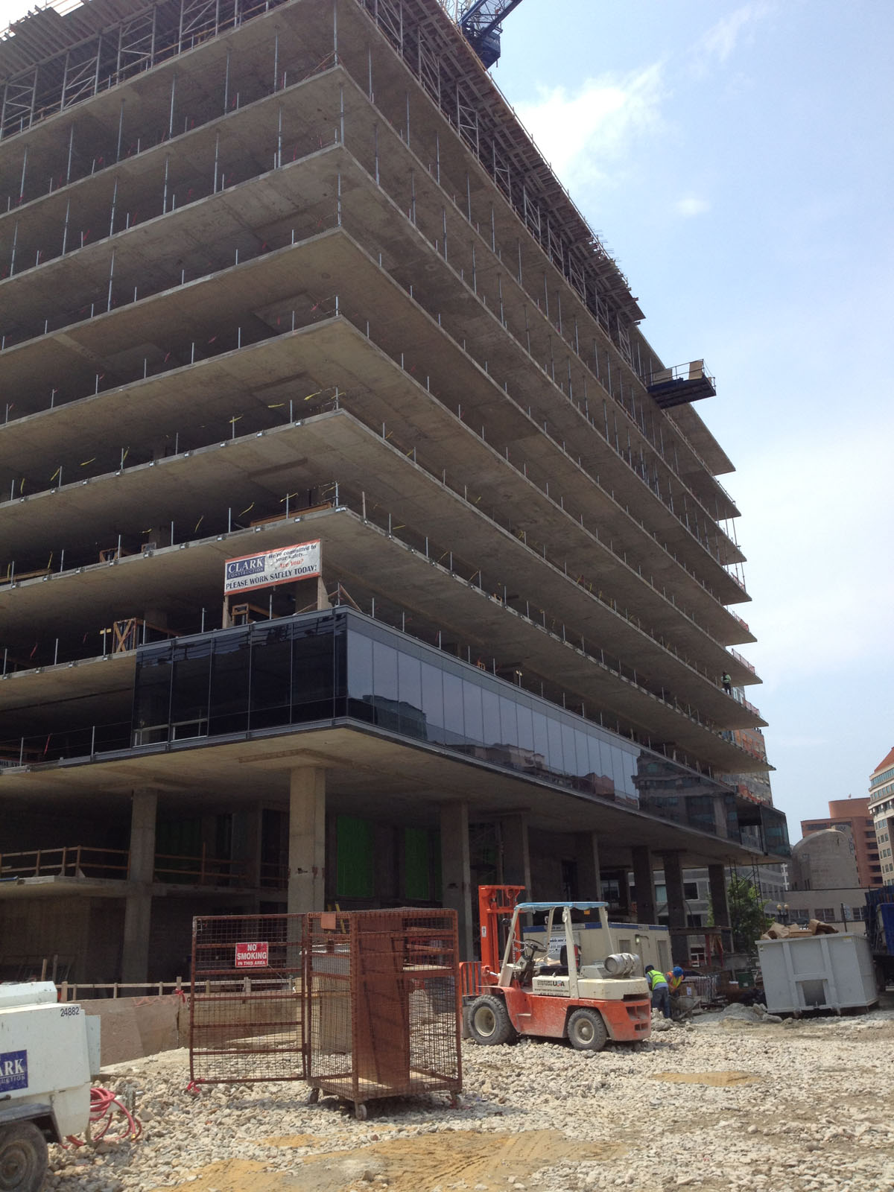
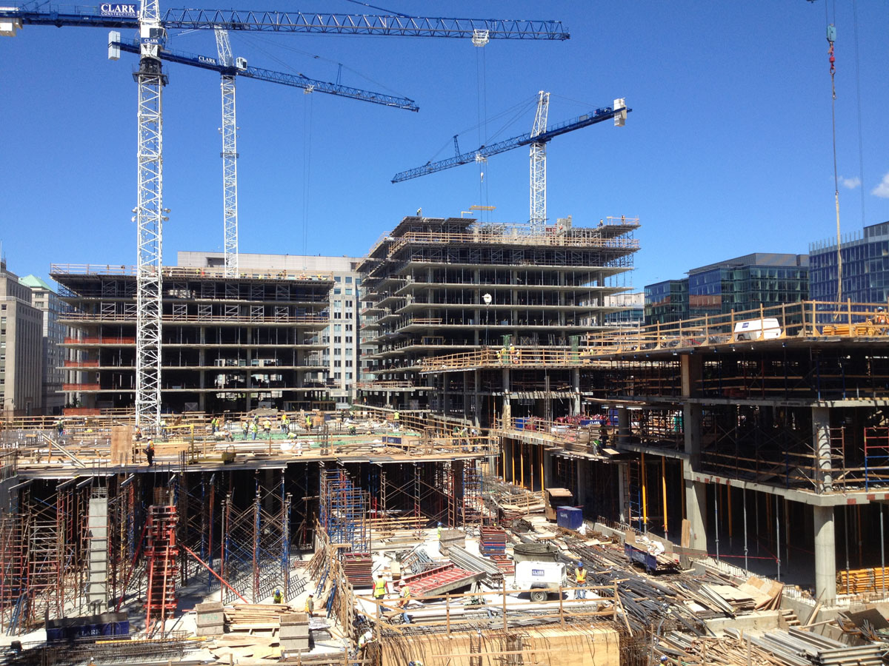
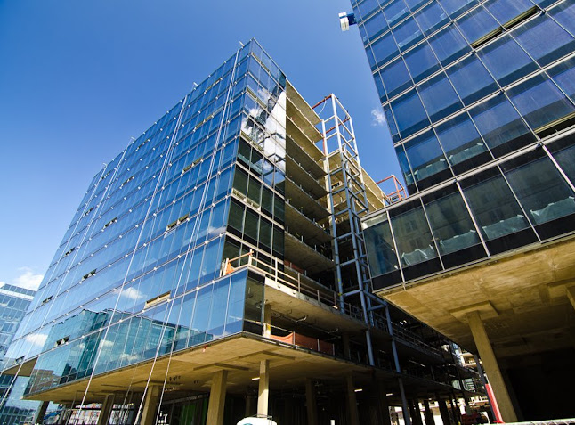
CityCenterDC | Parcel 1
Washington, D.C.
Project Overview
Analysis #1: SIPS
Background Information
New Phasing & SIPS
Impact
Analysis #2: Electrical Redesign
Background Information
Redesign
Impact
Analysis #3: Footbridge Installation
Background Information
Research
Application
Results
Final Recommendations
Acknowledgements

Slide 33
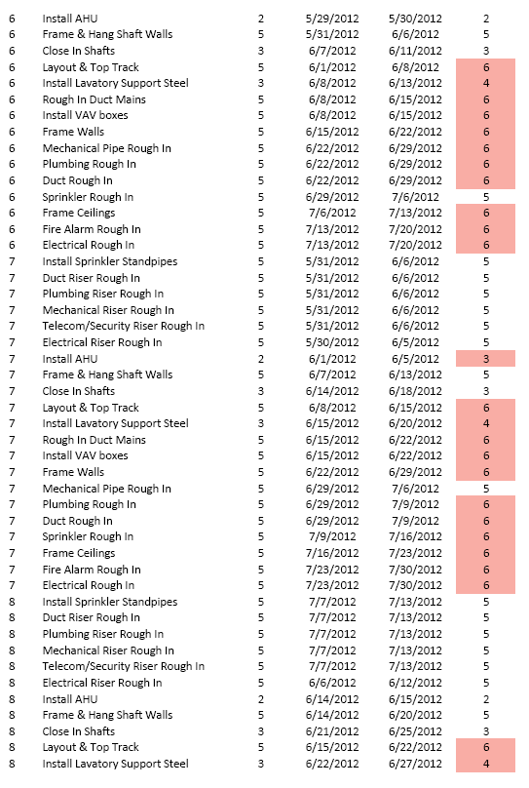
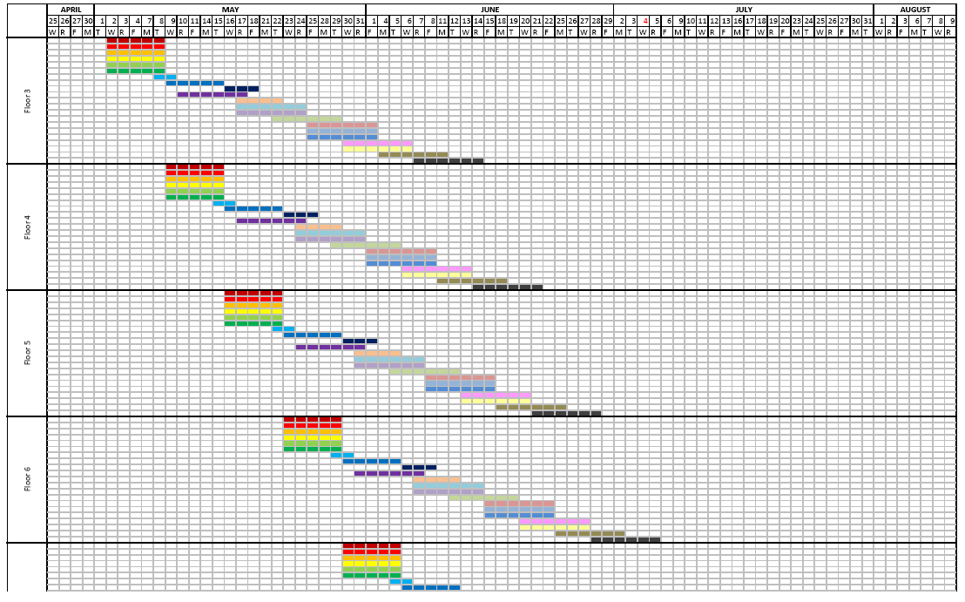
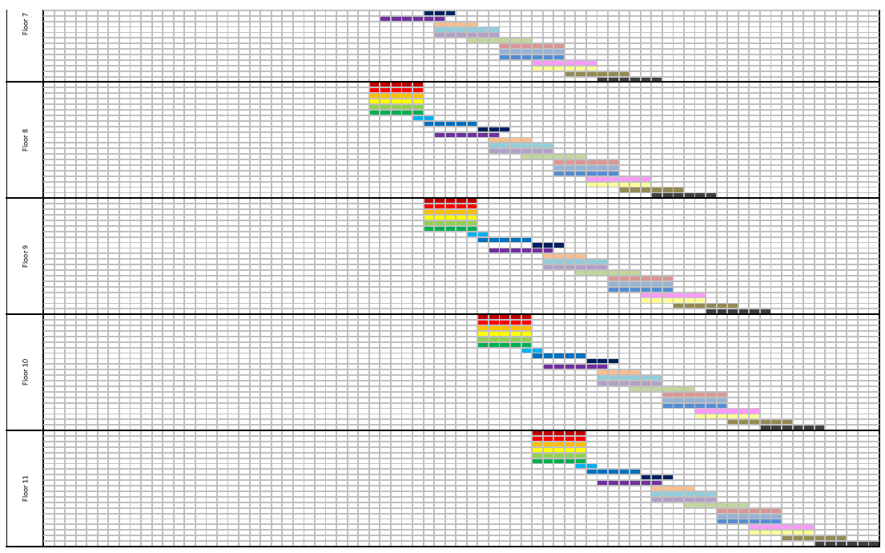
Appendix
CityCenterDC | Parcel 1
Washington, D.C.

Slide 34







Appendix
CityCenterDC | Parcel 1
Washington, D.C.

Slide 35




Appendix
CityCenterDC | Parcel 1
Washington, D.C.

Slide 36



Appendix
CityCenterDC | Parcel 1
Washington, D.C.

Slide 37



Appendix
CityCenterDC | Parcel 1
Washington, D.C.

Slide 38



Appendix
CityCenterDC | Parcel 1
Washington, D.C.

Slide 39




Appendix
CityCenterDC | Parcel 1
Washington, D.C.

